Slide 1
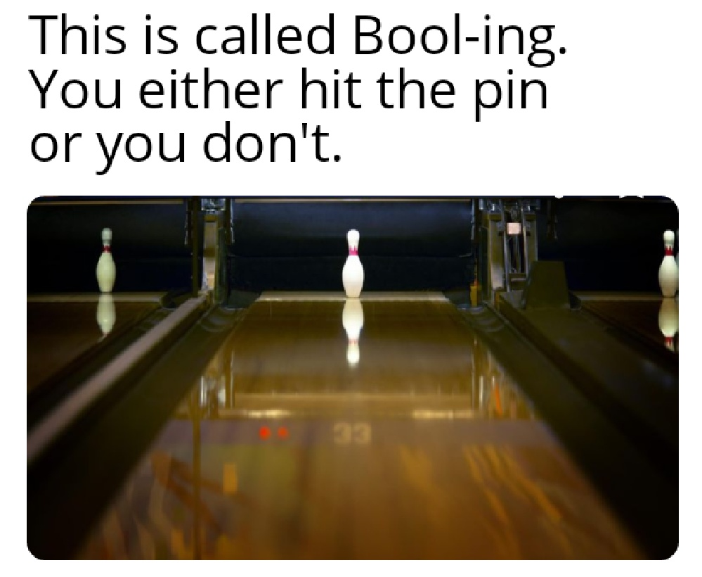
Digital Logic, Binary, Hex and Ascii

Slide 2
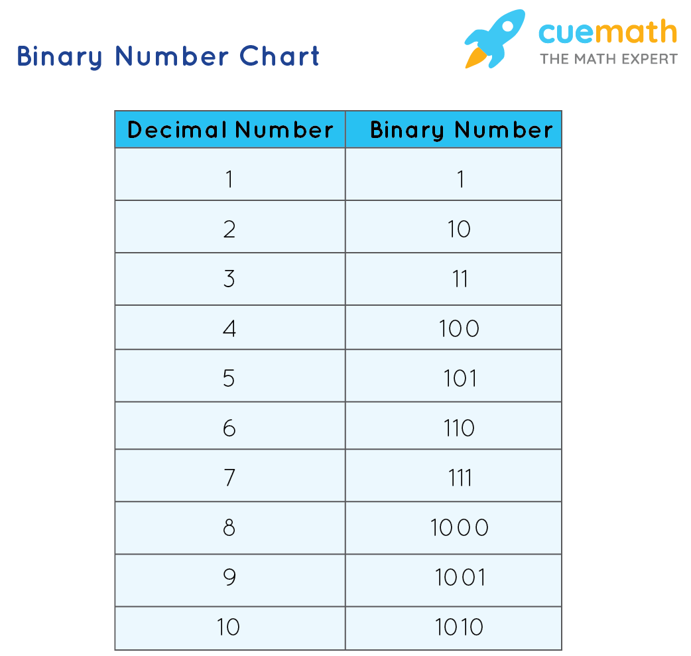
BINARY:
A Base-2 Numeral System
Uses only 1s and 0s
Found everywhere in real life:
True/False
On/Off
Light/Dark
Open/Closed

Slide 3
Binary Converstions
Convert the following from binary to Decimal
1
1100
10111
11110
11010110
1
12
23
30
214

Slide 4
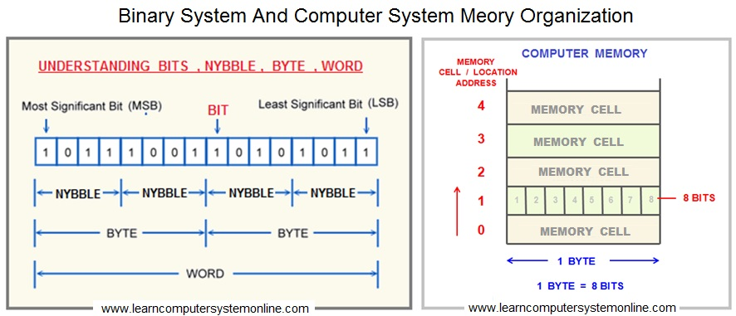
Uses in Computers:
Binary makes up the foundation of computers
All data handled by computers are broken down and modified in binary form.
1 bit = a single 1 or 0,
8 bits = 1 byte
Used in IP addresses

Slide 5
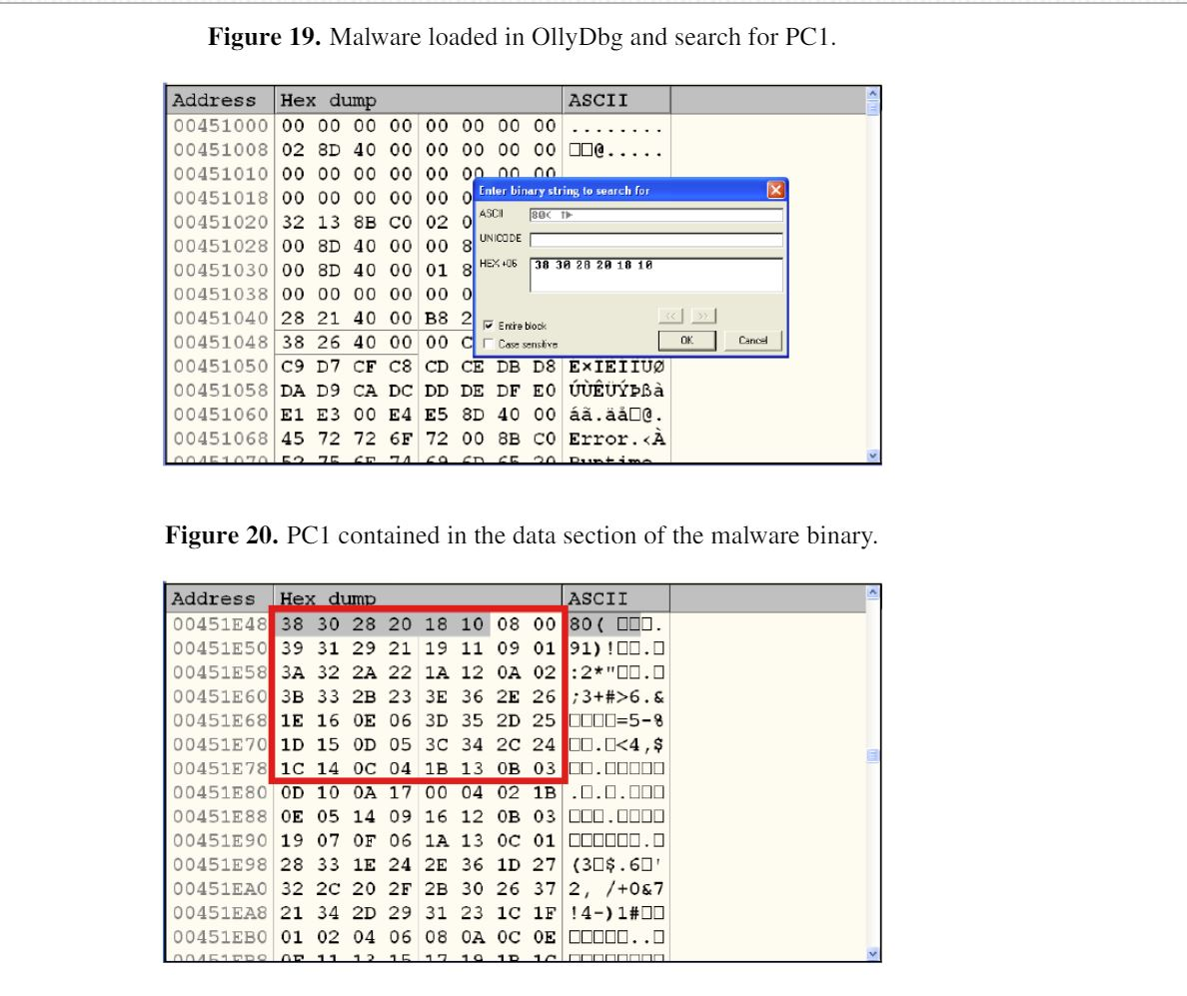
Binary in Cybersecurity
Buffer Overflow attacks:
Input writes too much data to memory of a program, thus “overflowing” the program, allowing undesired actions to happen
Malware/Ransomware Analysis
Programs are manipulated at the binary level and researchers often look to the binary for clues and information

Slide 6
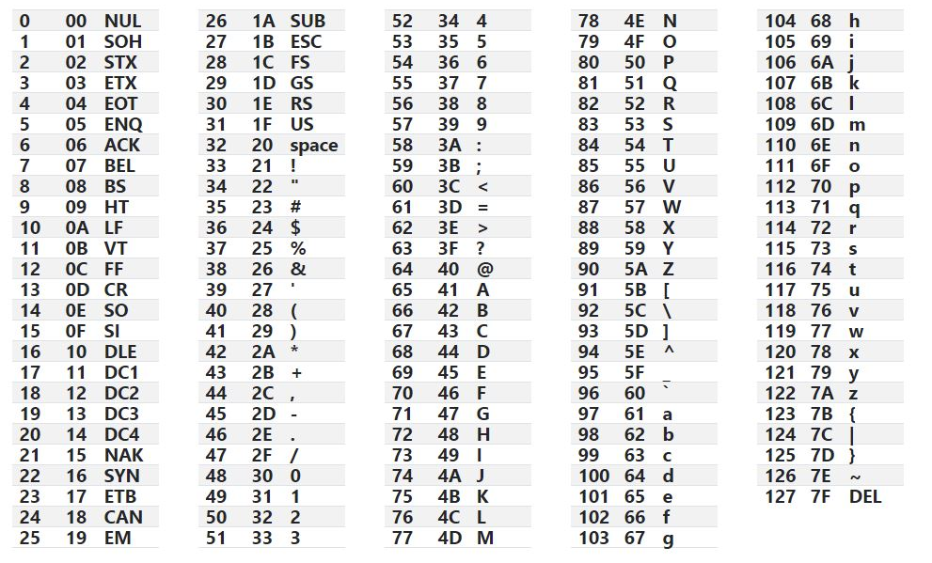

Hexadecimal & ASCII
Two other forms of data representation
ASCII are characters as we understand
Hexadecimal is a base-16 numeral system used to make low level data more readable

Slide 7
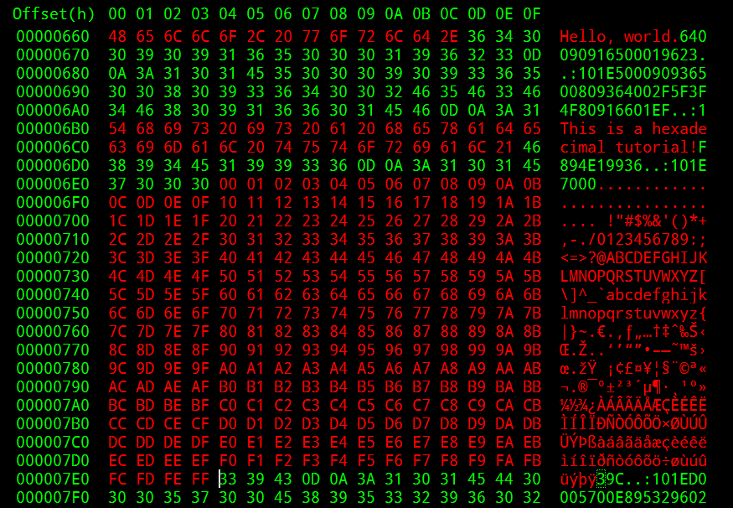
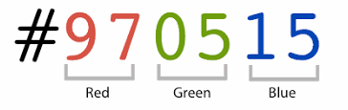
Hexadecimal in action:
Wireshark Network Packets
Color Palette
Programming in General

Slide 8
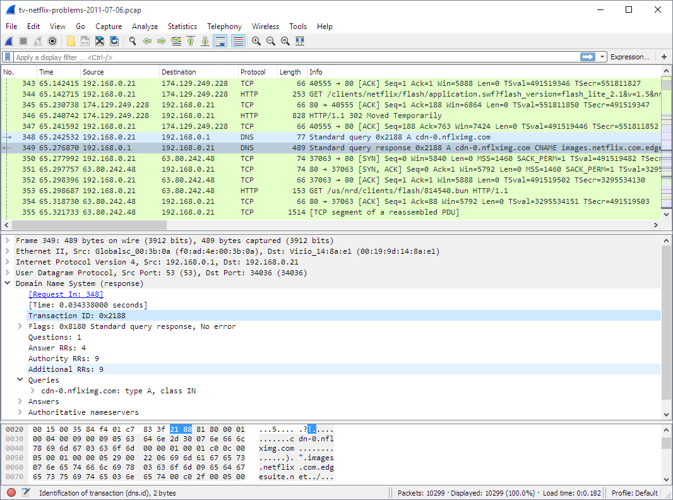

Slide 9
XXD Command
View Files in Binary and Hex
-b for binary, - g for bytes

Slide 10
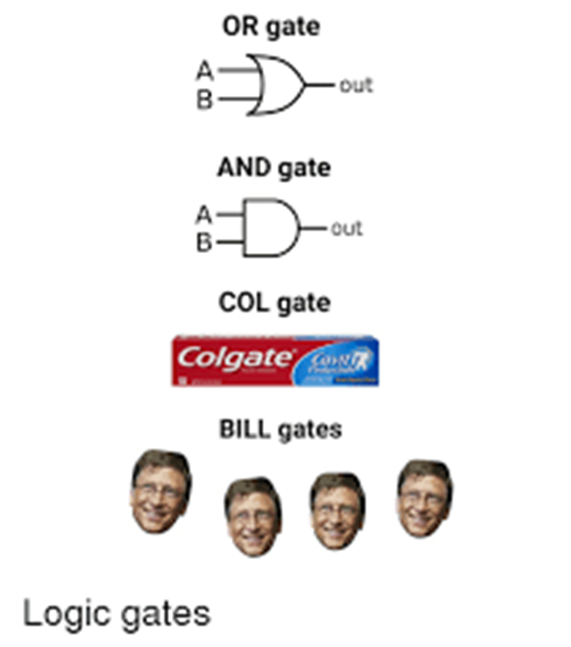
DIGITAL LOGIC:
Also known as Boolean Logic, is the fundamental principle underneath all of computing.
It quite literally is the use of all the 1s and 0s from the ground up.

Slide 11
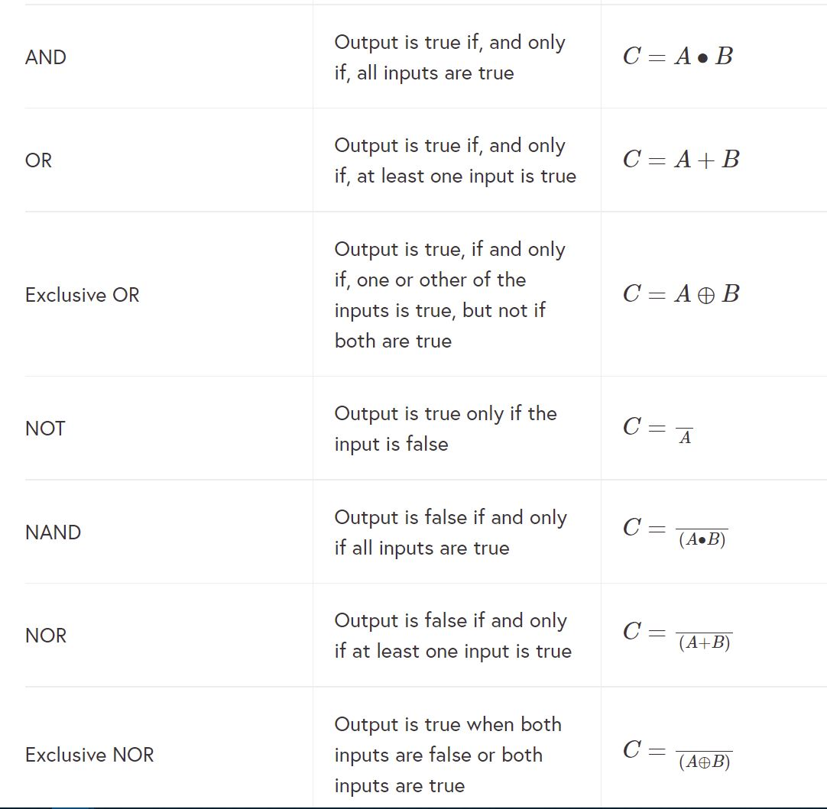
LOGIC GATES
6 main functions
OR
AND
XOR
NOT
NOR
NAND
Shown via Truth Tables >

Slide 12
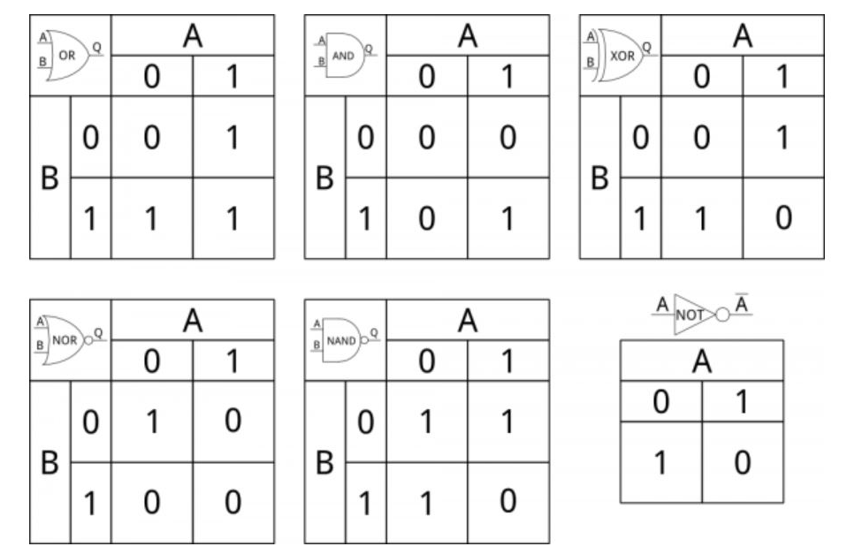
Logic in Truth Tables
Used to perform calculations and manipulate data
Start as individual gates with inputs, and combine to build all parts of a computer’s motherboard

Slide 13
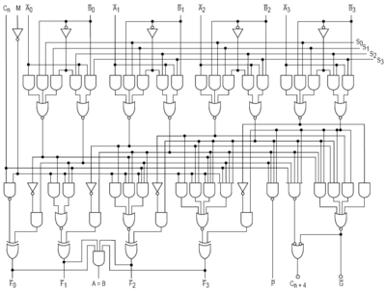
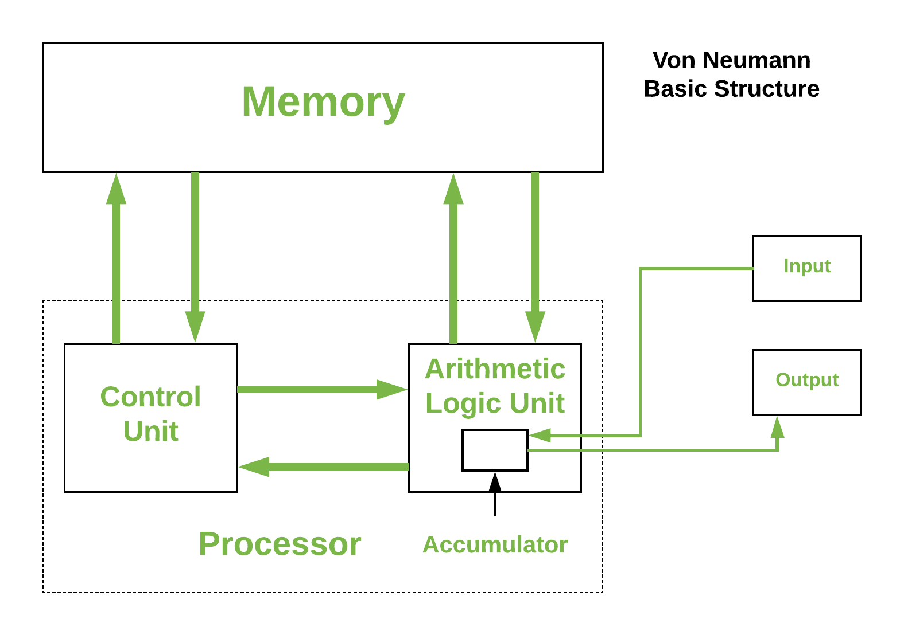
From Gates to Architecture:

Slide 14
What is the output of this program?
way_fairer = 2.7
StickleyMan = 2.3
_vargas_ = 2.3
smeeee = 1.3
a = way_fairer > StickleyMan
b = StickleyMan < smeeee and a
c = a and b or smeeee > 1.2 # TRUE
d = not ((a and b) or c)
if d:
print("TRUE")
else:
print("FALSE")

Slide 15
Solution: FALSE
A = 2.7 > 2.3 == TRUE
B = 2.3 < 1.3 AND A == FALSE AND TRUE == FALSE
C= true AND false OR ( 1.3 > 1.2) = FALSE OR TRUE == TRUE
D= # not ( ( TRUE AND FALSE) OR TRUE) == FALSE
Returns: FALSE

Slide 16
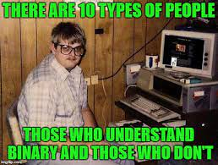
MAPSCII
sudo apt-get install telnet
telnet mapscii.me

